Slide 1
PERCEPTION

Slide 2
It’s is the way we view the world around us.

Slide 3
LEARNING OBJECTIVES
Perception—Meaning and definition
Perceptual process
Importance of perception in OB

Slide 4
DEFINITION
Perception can be defined as the process of receiving, selecting, organizing, interpreting, checking, and reacting to sensory stimuli or data.

Slide 5
Perception can be defined as a process by which individuals organize and interpret their sensory impressions in order to give meaning to their environments.

Slide 6
KEY FEATURE
It ‘s a cognitive process.
The perceptual world may be different from the world of reality.
The world as it is perceived is the world that is behaviourally important.

Slide 7
KEY ELEMENTS
receiving,
selecting,
organizing,
interpreting,
checking, and
reacting

Slide 8
FACTORS AFFECTING PERCEPTION

Slide 9
Factors in the perceiver
Attitudes
Motives
Interests
Experience
Expectations
Factors in the situation
Time
Work setting
Social setting
Perception
Factors in the target:
Novelty
Motion
Sound
Size
Background
Proximity
Similarity

Slide 10
SENSATION VS PERCEPTION
Sensation | Perception
It’s the physical functioning of the physical senses | It’s filtering, modifying or even changing the stimuli
It’s not cognitive | It’s cognitive
It’s part of perception. | It’s the whole.

Slide 11
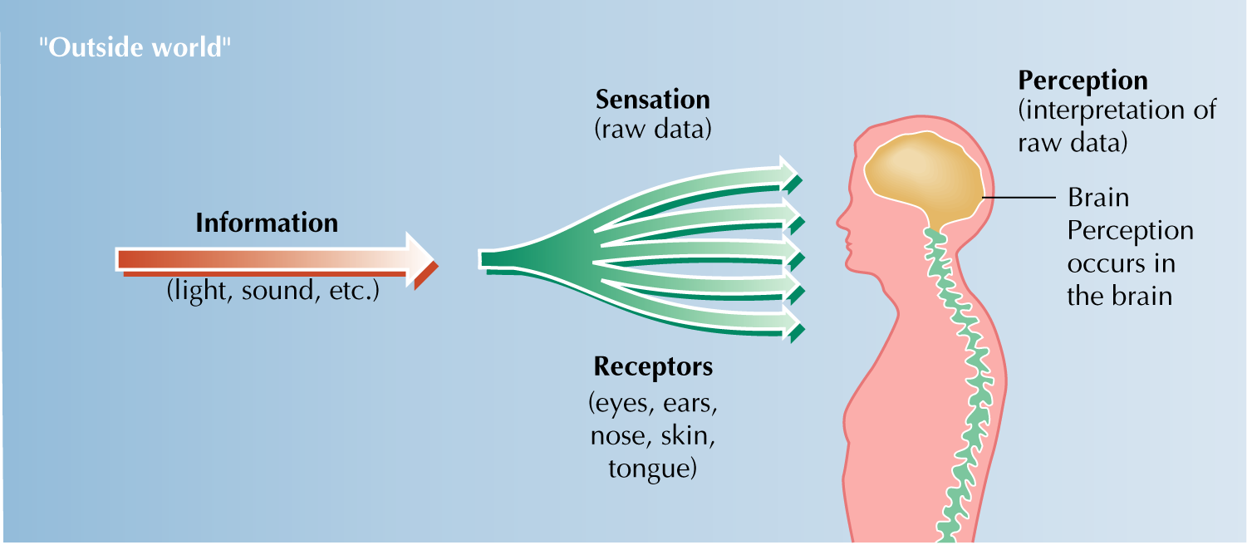

Slide 12
“It is the brain that smells, but not the nose”.

Slide 13
PERCEPTUAL PROCESS
1. Receiving of stimuli
2. Selecting stimuli
3. Organizing
4. Interpreting
5. Checking
6. Reacting

Slide 14
RECEIVING OF STIMULI
It is sensation.
It’s a physiological process.

Slide 15
Hearing
touching
Receiving
Seeing
Tasting
Smelling
Sensation

Slide 16
SELECTING

Slide 18
EXTERNAL FACTORS
Nature
Location
Intensity
Size
Contrast

Slide 20
CONTD…
Movement
Repetition
Novelty and familiarity

Slide 21
INTERNAL FACTORS
Learning
TURN OFF THHE ENGIENE.

Slide 22
M-A-C-D-O-W-E-L-L

Slide 23
M-A-C-M-I-L-L-A-N

Slide 24
M-A-C-M-I-L-L-I-O-N

Slide 25
M-A-C-H-E-N-E-R-Y

Slide 26
M-A-C-H-I-N-E-R-Y

Slide 27
CONTD…
Psychological Needs
Age ( Generation gap)
Interest

Slide 28
ORGANIZING
It’s organizing the bits of information into a meaningful whole.

Slide 29
DIMENSIONS OF ORGANIZING

Slide 30
FIGURE-GROUND PRINCIPLE
Figure: the meaningful bits and pieces of stimuli
Ground: the meaningless bits and pieces of stimuli

Slide 32
PERCEPTUAL GROUPING
Closure
Continuity
Proximity
Similarity

Slide 33

Closure

Slide 34


Slide 35
Continuity
It’s the continuity of pattern.
It leads to non-creativity.

Slide 36
Proximity

Slide 39
Similarity
- - - - - - - -
₊ ₊ ₊ ₊ ₊ ₊ ₊
₋ ₋ ₋ ₋ ₋ ₋ ₋ ₋
₊ ₊ ₊ ₊ ₊ ₊ ₊ ₊

Slide 40
PERCEPTUAL CONSTANCY
The size, shape, colour, brightness, and location of an object are fairly constant regardless of the information/stimuli perceived by the senses.

Slide 41
PERCEPTUAL CONTEXT
It gives a context for interpreting the stimuli.

Slide 42
INTERPRETING
Interpreting is meaning-giving.

Slide 43
INTERPRETING
Perceptual set
Attribution
(types: Status, intention and status)
Stereotyping
(Americans are materialistic.)
Halo effect
(Overrating negative: rusty halo or horns effect )

Slide 44
INTERPRETENING (CONTD..)
Projection
Implicit personality theory
(Honest Hardworking; Religious outspoken)
Self-serving bias
(White House statements: “Mission accomplished” or “Intelligence failure” ?)

Slide 45
CHECKING
Two ways of checking are:
Introspection/self-analysis.
With others.

Slide 46
Reacting
Resultant behaviour emerging from the perceptual process

Slide 47
PERCEPTION AND OB
PERCEPTION
DECISION-MAKING/JUDGING

Slide 48
Employment Interview
Performance Appraisal
Performance Expectation
Employee Effort
Employee Loyalty
Impression Management

